Slide 1
Guide to Computer Forensics and Investigations
Fourth Edition
Chapter 5
Processing Crime and Incident Scenes

Slide 2
Objectives
Explain the rules for digital evidence
Describe how to collect evidence at private-sector incident scenes
Explain guidelines for processing law enforcement crime scenes
List the steps in preparing for an evidence search
Describe how to secure a computer incident or crime scene

Slide 3
Objectives (continued)
Explain guidelines for seizing digital evidence at the scene
List procedures for storing digital evidence
Explain how to obtain a digital hash
Review a case to identify requirements and plan your investigation

Slide 4
Identifying Digital Evidence

Slide 5
Identifying Digital Evidence
Digital evidence
  Can be any information stored or transmitted in digital form
U.S. courts accept digital evidence as physical evidence
  Digital data is a tangible object
Some require that all digital evidence be printed out to be presented in court

Slide 6
Identifying Digital Evidence (continued)
General tasks investigators perform when working with digital evidence:
  Identify digital information or artifacts that can be used as evidence
  Collect, preserve, and document evidence
  Analyze, identify, and organize evidence
  Rebuild evidence or repeat a situation to verify that the results can be reproduced reliably
Collecting computers and processing a criminal or incident scene must be done systematically

Slide 7
Understanding Rules of Evidence
Consistent practices help verify your work and enhance your credibility
Comply with your state’s rules of evidence or with the Federal Rules of Evidence
Evidence admitted in a criminal case can be used in a civil suit, and vice versa
Keep current on the latest rulings and directives on collecting, processing, storing, and admitting digital evidence

Slide 8
Understanding Rules of Evidence (continued)
Data you discover from a forensic examination falls under your state’s rules of evidence
  Or the Federal Rules of Evidence
Digital evidence is unlike other physical evidence because it can be changed more easily
  The only way to detect these changes is to compare the original data with a duplicate
Most federal courts have interpreted computer records as hearsay evidence
  Hearsay is secondhand or indirect evidence

Slide 9
Understanding Rules of Evidence (continued)
Business-record exception
  Allows “records of regularly conducted activity,” such as business memos, reports, records, or data compilations
Generally, computer records are considered admissible if they qualify as a business record
Computer records are usually divided into:
  Computer-generated records
  Computer-stored records

Slide 10
Understanding Rules of Evidence (continued)
Computer records must be shown to be authentic and trustworthy
  To be admitted into court
Computer-generated records are considered authentic
  If the program that created the output is functioning correctly
Collecting evidence according to the proper steps of evidence control helps ensure that the computer evidence is authentic

Slide 11
Understanding Rules of Evidence (continued)
When attorneys challenge digital evidence
  Often they raise the issue of whether computer-generated records were altered
    Or damaged after they were created
One test to prove that computer-stored records are authentic is to demonstrate that a specific person created the records
  The author of a Microsoft Word document can be identified by using file metadata

Slide 12
Demo: Metadata in FTK
Save a Word document
In FTK:
  Click No, OK, OK through the demo warning boxes
  Go directly to working with program
  File, Add Evidence
  Enter your name, Next, Next
  Click "Add Evidence" button
  Click "Individual File", Continue
  Navigate to Word document,double-click it
  OK, Next, Continue

Slide 13
FTK Demo
In "File Category", click the Documents button
Select the document in the lower pane
"View files in native format" shows the text typed into the Word document
"View files in filtered text format" shows the metadata, such as the registered owner of the program

Slide 14
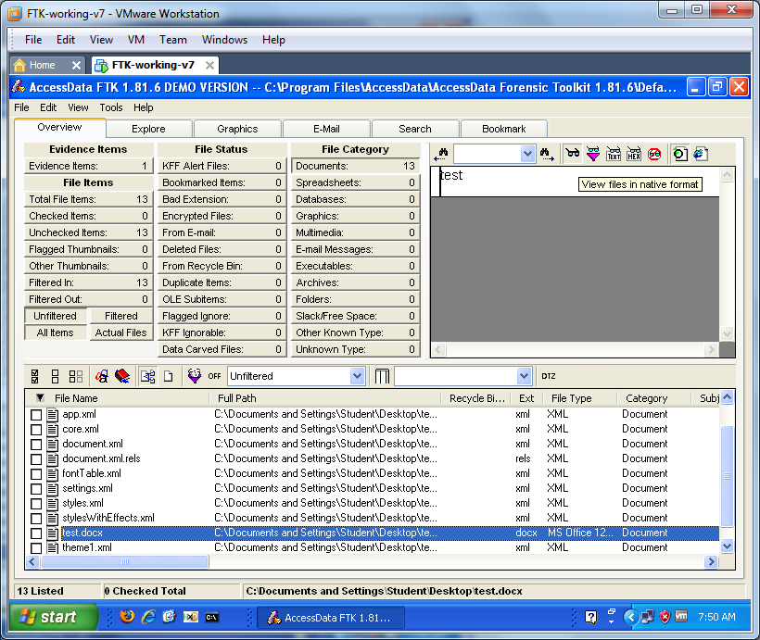

Slide 15
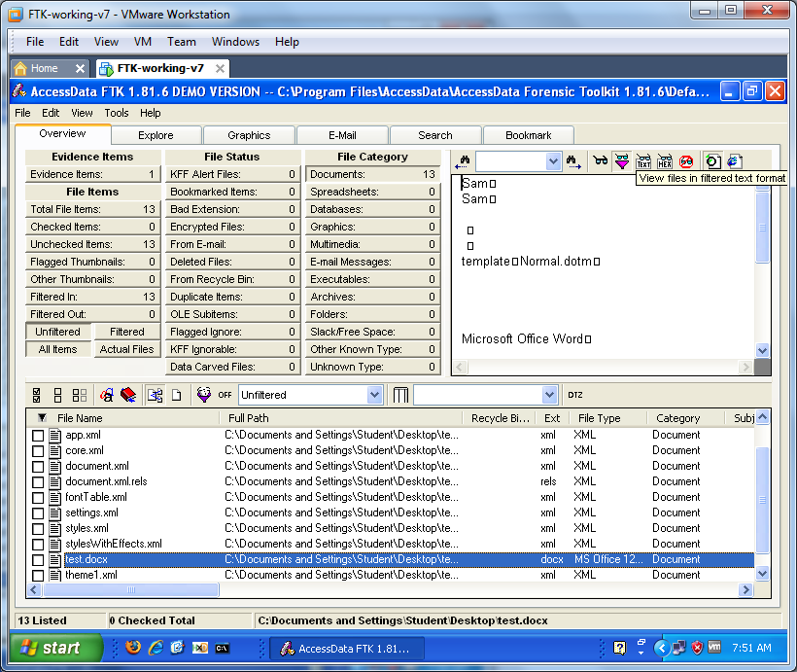

Slide 16
Understanding Rules of Evidence (continued)
The process of establishing digital evidence’s trustworthiness originated with written documents and the best evidence rule
Best evidence rule states:
  To prove the content of a written document, recording, or photograph, ordinarily the original writing, recording, or photograph is required

Slide 17
Understanding Rules of Evidence (continued)
Federal Rules of Evidence
  Allow a duplicate instead of originals when it is "produced by the same impression as the original … by mechanical or electronic re- recording … or by other equivalent techniques which accurately reproduce the original."
As long as bit-stream copies of data are created and maintained properly
  The copies can be admitted in court, although they aren’t considered best evidence

Slide 18
When a Copy is All You Have
If the hard drive crashes after you make the copy
If removing the original computers is not possible, because it would cause harm to a business or its owner, who might be an innocent bystander
  Steve Jackson Games was harmed in this manner when the Secret Service seized all computers because BBS users placed evidence of a crime on them
  The company sued and won (link Ch 5a)

Slide 19
Collecting Evidence in Private-Sector Incident Scenes

Slide 20
Collecting Evidence in Private-Sector Incident Scenes
Private-sector organizations include:
  Businesses and government agencies that aren’t involved in law enforcement
Agencies must comply with state public disclosure and federal Freedom of Information Act (FOIA) laws
  And make certain documents available as public records
FOIA allows citizens to request copies of public documents created by federal agencies

Slide 21
Collecting Evidence in Private-Sector Incident Scenes (continued)
A special category of private-sector businesses includes ISPs and other communication companies
ISPs can investigate computer abuse committed by their employees, but not by customers
  Except for activities that are deemed to create an emergency situation
Investigating and controlling computer incident scenes in the corporate environment
  Much easier than in the criminal environment
  Incident scene is often a workplace

Slide 22
Collecting Evidence in Private-Sector Incident Scenes (continued)
Typically, businesses have inventory databases of computer hardware and software
  Help identify the computer forensics tools needed to analyze a policy violation
    And the best way to conduct the analysis
Corporate policy statement about misuse of computing assets
  Allows corporate investigators to conduct covert surveillance with little or no cause
  And access company systems without a warrant

Slide 23
Collecting Evidence in Private-Sector Incident Scenes (continued)
Companies should display a warning banner or publish a policy, or both
  Stating that they reserve the right to inspect computing assets at will
Corporate investigators should know under what circumstances they can examine an employee’s computer
  Every organization must have a well-defined process describing when an investigation can be initiated

Slide 24
Collecting Evidence in Private-Sector Incident Scenes (continued)
If a corporate investigator finds that an employee is committing or has committed a crime
  Employer can file a criminal complaint with the police
Employers are usually interested in enforcing company policy
  Not seeking out and prosecuting employees
Corporate investigators are, therefore, primarily concerned with protecting company assets

Slide 25
Collecting Evidence in Private-Sector Incident Scenes (continued)
If you discover evidence of a crime during a company policy investigation
  Determine whether the incident meets the elements of criminal law
  Inform management of the incident
  Stop your investigation to make sure you don’t violate Fourth Amendment restrictions on obtaining evidence
  Work with the corporate attorney to write an affidavit confirming your findings

Slide 26
Becoming an Agent of Law Enforcement
If law enforcement officers ask you to find more information, you are at legal risk
  Don’t do any further investigation until you receive a subpoena or court order

Slide 27
Processing Law Enforcement Crime Scenes

Slide 28
Processing Law Enforcement Crime Scenes
You must be familiar with criminal rules of search and seizure
You should also understand how a search warrant works and what to do when you process one
Law enforcement officer may search for and seize criminal evidence only with probable cause
  Facts or circumstances that lead a reasonable person to believe a crime has been committed or is about to be committed

Slide 29
Processing Law Enforcement Crime Scenes (continued)
With probable cause, a police officer can obtain a search warrant from a judge
  That authorizes a search and seizure of specific evidence related to the criminal complaint
The Fourth Amendment states that only warrants “particularly describing the place to be searched, and the persons or things to be seized” can be issued

Slide 30
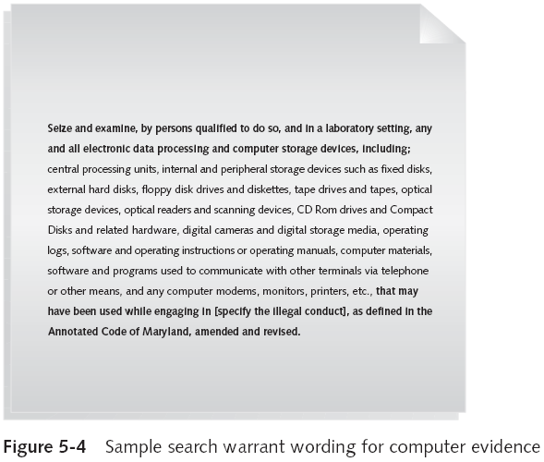

Slide 31
Understanding Concepts and Terms Used in Warrants
Innocent information
  Unrelated information
  Often included with the evidence you’re trying to recover
Judges often issue a limiting phrase to the warrant
  Allows the police to separate innocent information from evidence

Slide 32
Understanding Concepts and Terms Used in Warrants (continued)
Plain view doctrine
  Objects falling in plain view of an officer who has the right to be in position to have that view
    Are subject to seizure without a warrant and may be introduced in evidence
“Knock and announce”
  With few exceptions, warrants require that officers knock and announce their identity
    When executing a warrant

Slide 33
Preparing for a Search

Slide 34
Preparing for a Search
Preparing for a computer search and seizure
  Probably the most important step in computing investigations
To perform these tasks
  You might need to get answers from the victim and an informant
    Who could be a police detective assigned to the case, a law enforcement witness, or a manager or coworker of the person of interest to the investigation

Slide 35
Identifying the Nature of the Case
When you’re assigned a computing investigation case
  Start by identifying the nature of the case
    Including whether it involves the private or public sector
The nature of the case dictates how you proceed
  And what types of assets or resources you need to use in the investigation

Slide 36
Identifying the Type of Computing System
For law enforcement
  This step might be difficult because the crime scene isn’t controlled
If you can identify the computing system
  Estimate the size of the drive on the suspect’s computer
    And how many computers to process at the scene
Determine which OSs and hardware are involved

Slide 37
Determining Whether You Can Seize a Computer
The type of case and location of the evidence
  Determine whether you can remove computers
Law enforcement investigators need a warrant to remove computers from a crime scene
  And transport them to a lab
If removing the computers will irreparably harm a business
  The computers should not be taken offsite

Slide 38
Determining Whether You Can Seize a Computer (continued)
An additional complication is files stored offsite that are accessed remotely
If you aren’t allowed to take the computers to your lab
  Determine the resources you need to acquire digital evidence and which tools can speed data acquisition

Slide 39
Obtaining a Detailed Description of the Location
Get as much information as you can
Identify potential hazards
  Interact with your HAZMAT team
HAZMAT guidelines
  A HAZMAT technician may need to acquire the image, following your instructions
  You may need to put the target drive in a special HAZMAT bag
  HAZMAT technician can decontaminate the bag
  Check for high temperatures

Slide 40
Determining Who Is in Charge
Corporate computing investigations
  Require only one person to respond
Law enforcement agencies
  Handle large-scale investigations
  Designate lead investigators

Slide 41
Using Additional Technical Expertise
Look for specialists
  OSs
  RAID servers
  Databases
Finding the right person can be a challenge
Educate specialists in investigative techniques
  Prevent evidence damage

Slide 42
Determining the Tools You Need
Prepare tools using incident and crime scene information
Initial-response field kit
  Lightweight
  Easy to transport
Extensive-response field kit
  Includes all tools you can afford

Slide 43
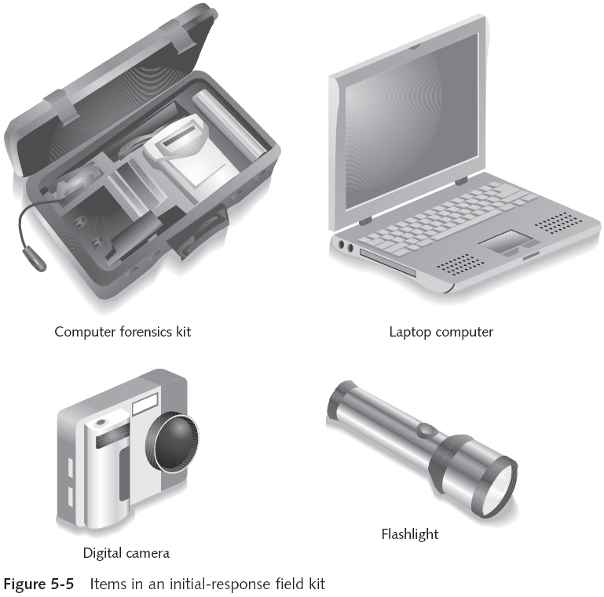

Slide 44
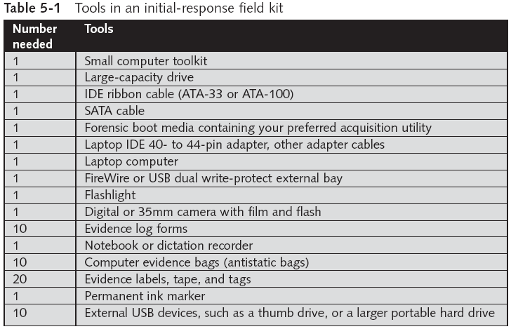

Slide 45
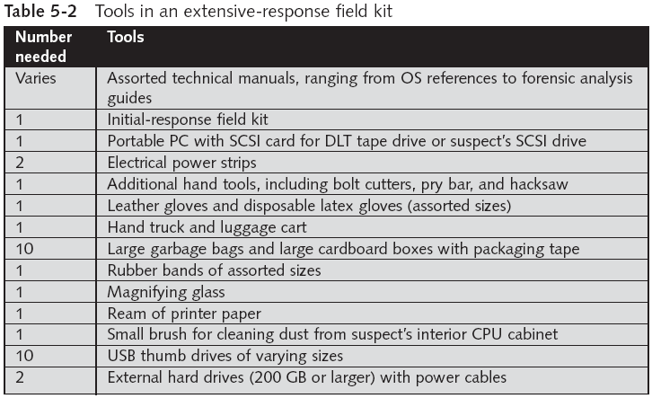

Slide 46
Preparing the Investigation Team
Review facts, plans, and objectives with the investigation team you have assembled
Goals of scene processing
  Collect evidence
  Secure evidence
Slow response can cause digital evidence to be lost

Slide 47
Securing a Computer Incident or Crime Scene

Slide 48
Securing a Computer Incident or Crime Scene
Goals
  Preserve the evidence
  Keep information confidential
Define a secure perimeter
  Use yellow barrier tape
  Legal authority: keep unnecessary people out but don’t obstruct justice or fail to comply with police officers
Professional curiosity can destroy evidence
  Involves police officers and other professionals who aren’t part of the crime scene processing team

Slide 49
Seizing Digital Evidence at the Scene

Slide 50
Seizing Digital Evidence at the Scene
Law enforcement can seize evidence
  With a proper warrant
Corporate investigators rarely can seize evidence
When seizing computer evidence in criminal investigations
  Follow U.S. DoJ standards for seizing digital data
Civil investigations follow same rules
  Require less documentation though
Consult with your attorney for extra guidelines

Slide 51
Preparing to Acquire Digital Evidence
The evidence you acquire at the scene depends on the nature of the case
  And the alleged crime or violation
Ask your supervisor or senior forensics examiner in your organization the following questions:
  Do you need to take the entire computer and all peripherals and media in the immediate area?
  How are you going to protect the computer and media while transporting them to your lab?
  Is the computer powered on when you arrive?

Slide 52
Preparing to Acquire Digital Evidence (continued)
Ask your supervisor or senior forensics examiner in your organization the following questions (continued):
  Is the suspect you’re investigating in the immediate area of the computer?
  Is it possible the suspect damaged or destroyed the computer, peripherals, or media?
  Will you have to separate the suspect from the computer?

Slide 53
Processing an Incident or Crime Scene
Guidelines
  Keep a journal to document your activities
  Secure the scene
    Be professional and courteous with onlookers
    Remove people who are not part of the investigation
  Take video and still recordings of the area around the computer
    Pay attention to details
  Sketch the incident or crime scene
  Check computers as soon as possible

Slide 54
Handling a Running Computer
Old rule: pull the plug
  Don’t cut electrical power to a running system unless it’s an older Windows 9x or MS-DOS system
Perform a live acquisition if possible
When shutting down Win XP or later, or Linux/Unix, perform a normal shutdown, to preserve log files
Save data from current applications as safely as possible
Record all active windows or shell sessions
Photograph the screen

Slide 55
Handling a Running Computer
  Make notes of everything you do when copying data from a live suspect computer
  Save open files to an external hard drive or a network share
    If that is not possible, save them with new names
  Close applications and shut down the computer

Slide 56
Processing an Incident or Crime Scene (continued)
Guidelines (continued)
  Bag and tag the evidence, following these steps:
    Assign one person to collect and log all evidence
    Tag all evidence you collect with the current date and time, serial numbers or unique features, make and model, and the name of the person who collected it
    Maintain two separate logs of collected evidence
    Maintain constant control of the collected evidence and the crime or incident scene

Slide 57
Processing an Incident or Crime Scene (continued)
Guidelines (continued)
  Look for information related to the investigation
    Passwords, passphrases, PINs, bank accounts
    Look at papers, in drawers, in trash cans
  Collect documentation and media related to the investigation
    Hardware, software, backup media, documentation, manuals

Slide 58
Processing Data Centers with RAID Systems
Sparse acquisition
  Technique for extracting evidence from large systems
  Extracts only data related to evidence for your case from allocated files
    And minimizes how much data you need to analyze
Drawback of this technique
  It doesn’t recover data in free or slack space

Slide 59
Using a Technical Advisor
Technical advisor
  Can help you list the tools you need to process the incident or crime scene
  Person guiding you about where to locate data and helping you extract log records
    Or other evidence from large RAID servers
  Can help create the search warrant by itemizing what you need for the warrant

Slide 60
Technical Advisor Responsibilities
Know aspects of the seized system
Direct investigator handling sensitive material
Help secure the scene
Help document the planning strategy for search and seizure
Conduct ad hoc trainings
Document activities
Help conduct the search and seizure

Slide 61
Documenting Evidence in the Lab
Record your activities and findings as you work
  Maintain a journal to record the steps you take as you process evidence
Goal is to be able to reproduce the same results
  When you or another investigator repeat the steps you took to collect evidence
A journal serves as a reference that documents the methods you used to process digital evidence

Slide 62
Processing and Handling Digital Evidence
Maintain the integrity of digital evidence in the lab
  As you do when collecting it in the field
Steps to create image files:
  Copy all image files to a large drive
  Start your forensics tool to analyze the evidence
  Run an MD5 or SHA-1 hashing algorithm on the image files to get a digital hash
  Secure the original media in an evidence locker

Slide 63
Storing Digital Evidence

Slide 64
Storing Digital Evidence
The media you use to store digital evidence usually depends on how long you need to keep it
CD-Rs or DVDs
  The ideal media
  Capacity: up to 17 GB
  Lifespan: 2 to 5 years
Magnetic tapes
  Capacity: 40 to 72 GB
  Lifespan: 30 years
  Costs: drive: $400 to $800; tape: $40

Slide 65
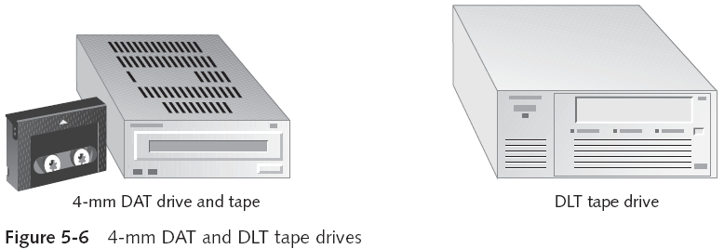
Storing Digital Evidence (continued)

Slide 66
Evidence Retention and Media Storage Needs
To help maintain the chain of custody for digital evidence
  Restrict access to lab and evidence storage area
Lab should have a sign-in roster for all visitors
  Maintain logs for a period based on legal requirements
You might need to retain evidence indefinitely
  Check with your local prosecuting attorney’s office or state laws to make sure you’re in compliance
  You cannot retain child pornography evidence, however

Slide 67
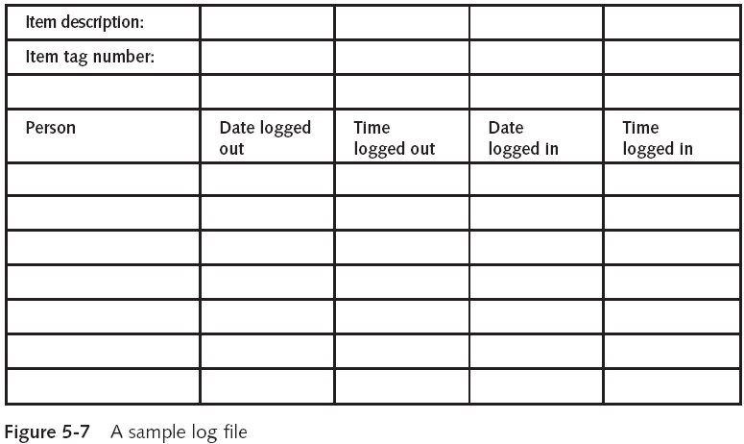
Evidence Retention and Media Storage Needs (continued)

Slide 68
Documenting Evidence
Create or use an evidence custody form
An evidence custody form serves the following functions:
  Identifies the evidence
  Identifies who has handled the evidence
  Lists dates and times the evidence was handled
You can add more information to your form
  Such as a section listing MD5 and SHA-1 hash values

Slide 69
Documenting Evidence (continued)
Include any detailed information you might need to reference
Evidence bags also include labels or evidence forms you can use to document your evidence

Slide 70
Obtaining a Digital Hash

Slide 71
Obtaining a Digital Hash
Cyclic Redundancy Check (CRC)
  Mathematical algorithm that determines whether a file’s contents have changed
  Most recent version is CRC-32
  Not considered a forensic hashing algorithm
Message Digest 5 (MD5)
  Mathematical formula that translates a file into a hexadecimal code value, or a hash value
  If a bit or byte in the file changes, it alters the digital hash

Slide 72
Obtaining a Digital Hash (continued)
Three rules for forensic hashes:
  You can’t predict the hash value of a file or device
  No two hash values can be the same
  If anything changes in the file or device, the hash value must change
Secure Hash Algorithm version 1 (SHA-1)
  A newer hashing algorithm
  Developed by the National Institute of Standards and Technology (NIST)

Slide 73
Obtaining a Digital Hash (continued)
In both MD5 and SHA-1, collisions have occurred
Most computer forensics hashing needs can be satisfied with a nonkeyed hash set
  A unique hash number generated by a software tool, such as the Linux md5sum command
Keyed hash set
  Created by an encryption utility’s secret key
You can use the MD5 function in FTK Imager to obtain the digital signature of a file
  Or an entire drive

Slide 74
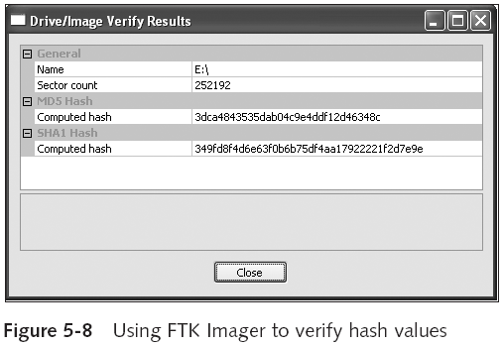
Obtaining a Digital Hash (continued)

Slide 75
Reviewing a Case

Slide 76
Reviewing a Case
General tasks you perform in any computer forensics case:
  Identify the case requirements
  Plan your investigation
  Conduct the investigation
  Complete the case report
  Critique the case

Slide 77
Sample Civil Investigation
Most cases in the corporate environment are considered low-level investigations
  Or noncriminal cases
Common activities and practices
  Recover specific evidence
    Suspect’s Outlook e-mail folder (PST file)
  Covert surveillance
    Its use must be well defined in the company policy
    Risk of civil or criminal liability
  Sniffing tools for data transmissions

Slide 78

Covert Surveillance Tools
Spector
WinWhatWhere
EnCase Enterprise Edition

Slide 79
Sample Criminal Investigation
Computer crimes examples
  Fraud
  Check fraud
  Homicides
Need a warrant to start seizing evidence
  Limit searching area

Slide 80
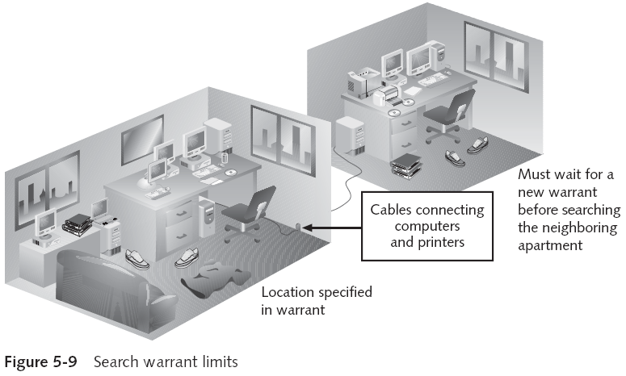
Sample Criminal Investigation (continued)

Slide 81
Reviewing Background Information for a Case
Company called Superior Bicycles
  Specializes in creating new and inventive modes of human-driven transportation
Two employees, Chris Murphy and Nau Tjeriko, have been missing for several days
A USB thumb drive has been recovered from Chris’s office with evidence that he had been conducting a side business using company computers

Slide 82
Identifying the Case Requirements
Identify requirements such as:
  Nature of the case
  Suspect’s name
  Suspect’s activity
  Suspect’s hardware and software specifications

Slide 83
Planning Your Investigation
List what you can assume or know
  Several incidents may or may not be related
  Suspect’s computer can contain information about the case
  If someone else has used suspect’s computer
Make an image of suspect’s computer disk drive
Analyze forensics copy

Slide 84
Conducting the Investigation: Acquiring Evidence with AccessData FTK
Functions
  Extract the image from a bit-stream image file
  Analyze the image

Slide 85
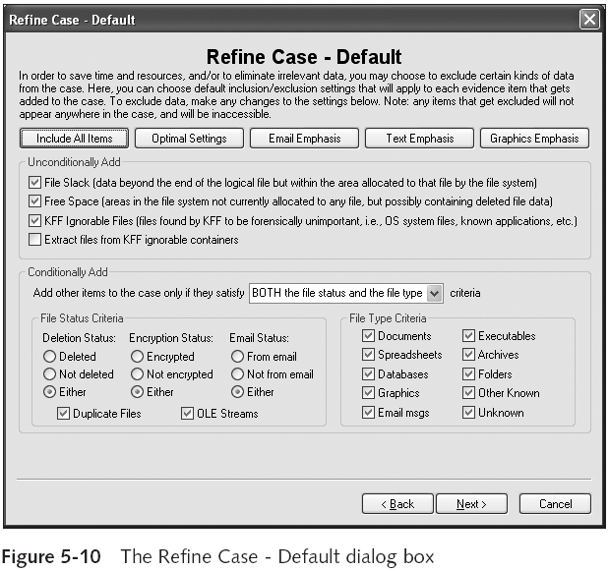

Slide 86
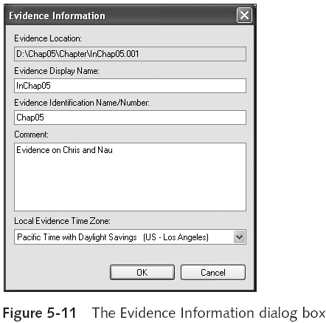
Conducting the Investigation: Acquiring Evidence with AccessData FTK (continued)

Slide 87
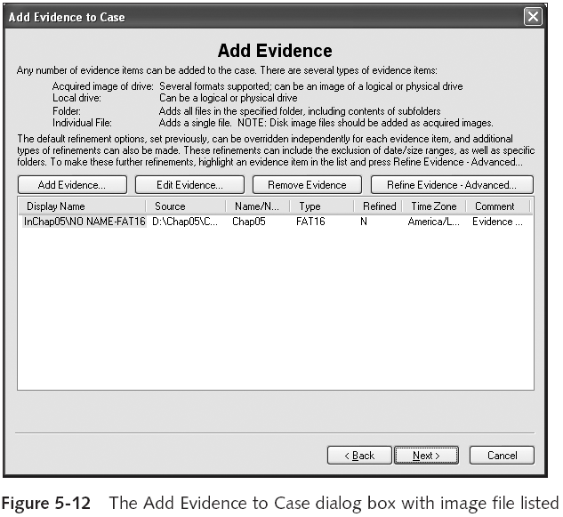

Slide 88
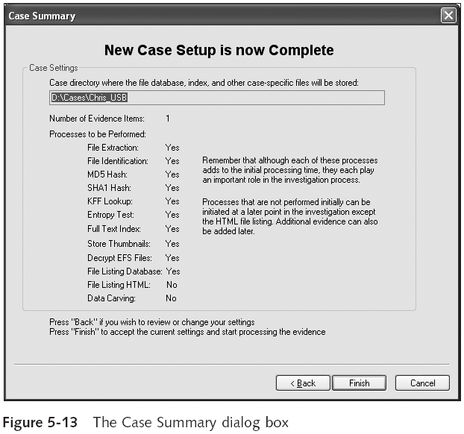

Slide 89
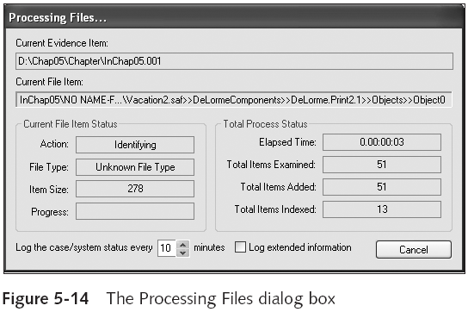
Conducting the Investigation: Acquiring Evidence with AccessData FTK (continued)

Slide 90
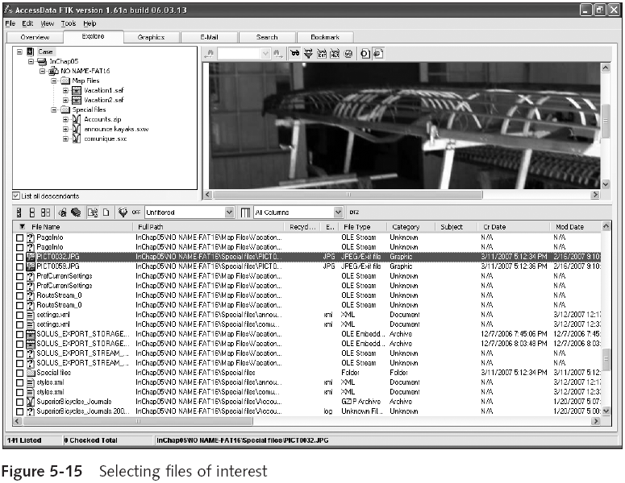

Slide 91
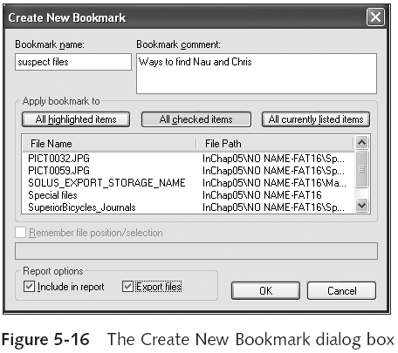
Conducting the Investigation: Acquiring Evidence with AccessData FTK (continued)

